Slide 1

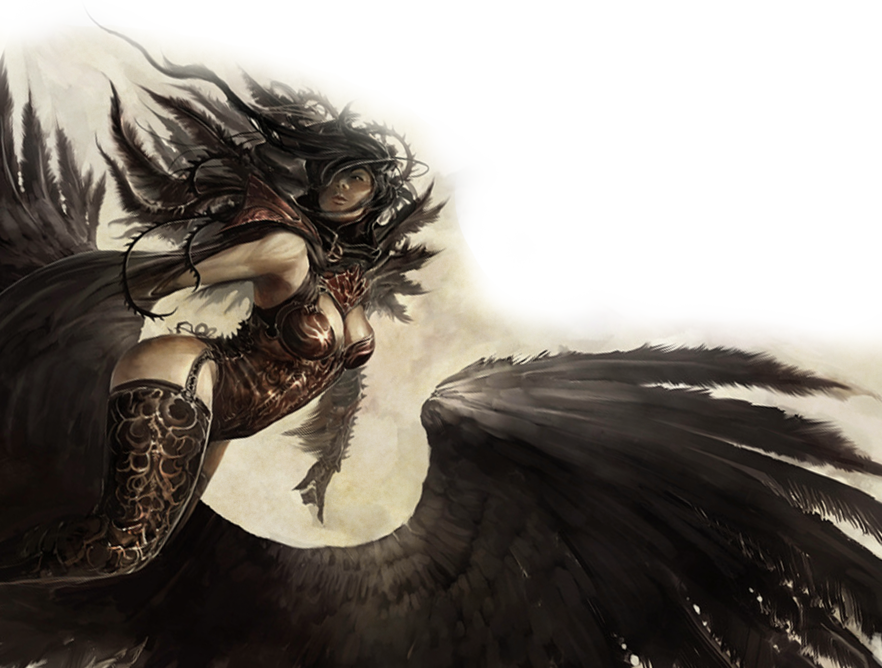
The Fallen
You have made a pact with a fallen angel, an angel that has committed an evil act that has marked them as an outcast. The angel may have rebelled against the powers they once served, seeking rulership over evil rather than good. Or they may still strive to be redeemed, working for good among the mortals of the Material plane. The being may have created the pact to further either its goals of evil or its dreams of redemption.
Expanded Spell list
The Fallen lets you choose from an expanded list of spells when you learn a warlock spell. The following spells are added to the warlock spell list for you.
Fallen Expanded Spells
Spell Level Spells
1st detect evil and good, command .
2nd see invisibility, zone of truth
3rd clairvoyance, tongues .
4th compulsion, divination
5th commune, dispel evil and good .
Blinding Gaze
Starting at 1st level, your patron bestows upon you the ability to blind foes with your angelic power. As an action, you can cause each creature in a 30-foot cone originating from you to make a Constitution saving throw against your warlock spell save DC. The creatures that fail their saving throws are all blinded until the end of your next turn.
Once you use this feature, you can't use it again until you finish a short or long rest.
Shimmering Shield
At 6th level, you can call upon your patron to grant you protection. When you are hit by an attack, you can use your reaction to grant yourself +3 AC until the start of your next turn, potentially causing the attack to miss you. If the attack misses you, the attacker must succeed on a Dexterity saving throw against your warlock spell save DC or take the damage of the attack themselves.
Once you use this feature, you can't use it again until you finish a short or long rest.
Divine Awareness
At 10th level, your powerful insight allows you to know when a creature is lying. Whenever you touch a creature, you can feel when they tell an outright lie, but you do not know when a creature is telling half-truths or withholding information.
Wings of the Fallen
Beginning at 14th level, you can gain the ability to grow a pair of black feathery wings from your back, gaining a flying speed equal to your current speed. You may create or dismiss these wings using a bonus action on your turn. While in flight, you may disengage as a bonus action.
You cannot create these wings while wearing armor, unless the armor is made to accommodate them, and clothing not made to accommodate your wings might be destroyed when you create them.

